Slide 1
Unit-7 Cluster Analysis
Compiled By:
Ghanashyam BK

Slide 2
Cluster Analysis
Cluster: a collection of data objects
Similar to one another within the same cluster
Dissimilar to the objects in other clusters
Cluster analysis
Finding similarities between data according to the characteristics found in the data and grouping similar data objects into clusters
Unsupervised learning: no predefined classes
Typical applications
As a stand-alone tool to get insight into data distribution
As a preprocessing step for other algorithms

Slide 3
Examples of Clustering Applications
Marketing: Help marketers discover distinct groups in their customer bases, and then use this knowledge to develop targeted marketing programs
Land use: Identification of areas of similar land use in an earth observation database
City-planning: Identifying groups of houses according to their house type, value, and geographical location
Earth-quake studies: Observed earth quake epicenters should be clustered along continent faults

Slide 4



Types of data in cluster analysis
Interval-scaled variables
Calculate the mean absolute deviation:
Where,
Calculate the standardized measurement (z-score)

Slide 5
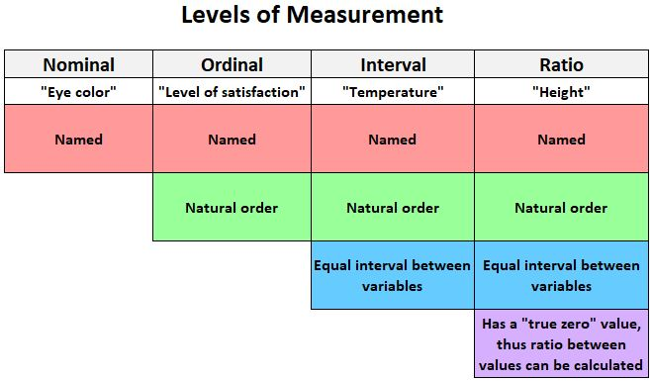
Types of data in cluster analysis
Binary variables, Nominal, Ordinal and Ratio variables

Slide 6


Similarity and dissimilarity between objects
Distances are normally used to measure the similarity or dissimilarity between two data objects
Some popular ones include: Minkowski distance:
Where, i = (x_{i1}, x_{i2}, …, x_{ip}) and j = (x_{j1}, x_{j2}, …, x_{jp}) are two p-dimensional data objects, and q is a positive integer.
If q = 1, d is Manhattan distance

Slide 7

Similarity and dissimilarity between objects
If q = 2, d is Euclidean distance:
Properties
d(i,j) >= 0
d(i,i) = 0
d(i,j) = d(j,i)
d(i,j) <= d(i,k) + d(k,j)
Also, one can use weighted distance, parametric Pearson product moment correlation, or other disimilarity measures

Slide 8
Major Clustering Approaches
Partitioning approach:
Construct various partitions and then evaluate them by some criterion, e.g., minimizing the sum of square errors
Typical methods: k-means, k-medoids, CLARANS
Hierarchical approach:
Create a hierarchical decomposition of the set of data (or objects) using some criterion
Typical methods: Agglomerative, Divisive, ROCK
Density-based approach:
Based on connectivity and density functions
Typical methods: DBSACN, OPTICS, DenClue

Slide 9
K-Means
An iterative algorithm that divides the unlabeled dataset into k different clusters in such a way that each dataset belongs only one group that has similar properties.
Here K defines the number of pre-defined clusters that need to be created in the process, as if K=2, there will be two clusters, and for K=3, there will be three clusters, and so on.
It is a centroid-based algorithm, where each cluster is associated with a centroid.
The main aim of this algorithm is to minimize the sum of distances between the data point and their corresponding clusters.

Slide 10
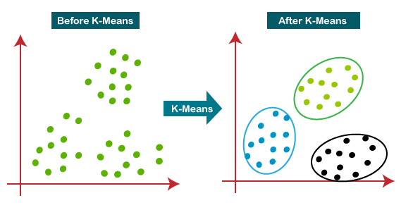
K-Means

Slide 11
K-Means(Algorithm)
Step-1:
Choose the number of clusters K.
Step-2:
Randomly select any K data points as cluster centers.
Select cluster centers in such a way that they are as farther as possible from each other.
Step-3:
Calculate the distance between each data point and each cluster center.
The distance may be calculated either by using given distance function or by using euclidean distance formula.
Step-4:
Assign each data point to some cluster.
A data point is assigned to that cluster whose center is nearest to that data point.

Slide 12
K-Means(Algorithm)
Step-5:
Re-compute the center of newly formed clusters.
The center of a cluster is computed by taking mean of all the data points contained in that cluster.
Step-6: Keep repeating the procedure from Step-3 to Step-5 until any of the following stopping criteria is met-
Center of newly formed clusters do not change
Data points remain present in the same cluster
Maximum number of iterations are reached

Slide 13
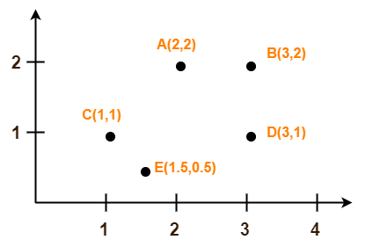
K-Means(Example)
Use K-Means Algorithm to create two clusters-
Solution
Assume C1=A(2, 2) and C2=C(1, 1) are centers of the two clusters.
Iteration-01:
We calculate the distance of each point from each of the center of the two clusters.
Calculating Distance Between A(2, 2) and C1(2, 2)-
Ρ(A, C1)
= sqrt [ (x2 – x1)² + (y2 – y1)² ]
= sqrt [ (2 – 2)² + (2 – 2)² ]
= sqrt [ 0 + 0 ]
= 0

Slide 14
K-Means(Example)
Calculating Distance Between A(2, 2) and C2(1, 1)-
Ρ(A, C2)
= sqrt [ (x2 – x1)² + (y2 – y1)² ]
= sqrt [ (1 – 2)² + (1 – 2)² ]
= sqrt [ 1 + 1 ]
= sqrt [ 2 ]
= 1.41
In the similar manner, we calculate the distance of other points from each of the center of the two clusters.

Slide 15
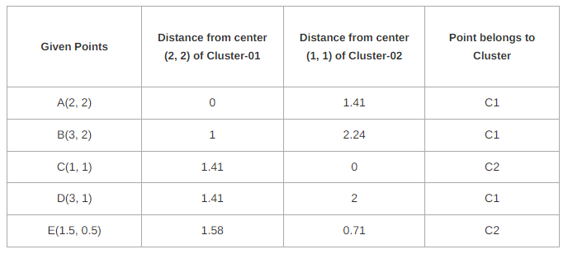
K-Means(Example)
Next, We draw a table showing all the results.
Using the table, we decide which point belongs to which cluster.
The given point belongs to that cluster whose center is nearest to it.

Slide 16
K-Means(Example)
Now, New clusters are-
Cluster-01: (A(2, 2), B(3, 2), E(1.5, 0.5), D(3, 1))
Cluster-02: (C(1, 1), E(1.5, 0.5))
Now,
We re-compute the new cluster clusters.
The new cluster center is computed by taking mean of all the points contained in that cluster.
For Cluster-01: Center of Cluster-01
= ((2 + 3 + 3)/3, (2 + 2 + 1)/3)
= (2.67, 1.67)
For Cluster-02: Center of Cluster-02
= ((1 + 1.5)/2, (1 + 0.5)/2)
= (1.25, 0.75)
This is completion of Iteration-01. Next, we go to iteration-02, iteration-03 and so on until the centers do not change anymore.

Slide 17
K-Means(Exercise)
Cluster the following eight points (with (x, y) representing locations) into three clusters:
A1(2, 10), A2(2, 5), A3(8, 4), A4(5, 8), A5(7, 5), A6(6, 4), A7(1, 2), A8(4, 9)
Initial cluster centers are: A1(2, 10), A4(5, 8) and A7(1, 2).
The distance function between two points a = (x1, y1) and b = (x2, y2) is defined as-
Ρ(a, b) = |x2 – x1| + |y2 – y1|
Use K-Means Algorithm to find the three cluster centers after the second iteration.

Slide 18
K-Means
Advantages:
easy to implement k-means and identify unknown groups of data from complex data sets.
It often terminates at local optimum.
Better computation cost.
Disadvantages:
It requires to specify the number of clusters (k) in advance.
It can not handle noisy data and outliers.
Centroids get dragged due to outliers in the dataset
Always tries to find circular clusters
It is not suitable to identify clusters with non-convex shapes.

Slide 19
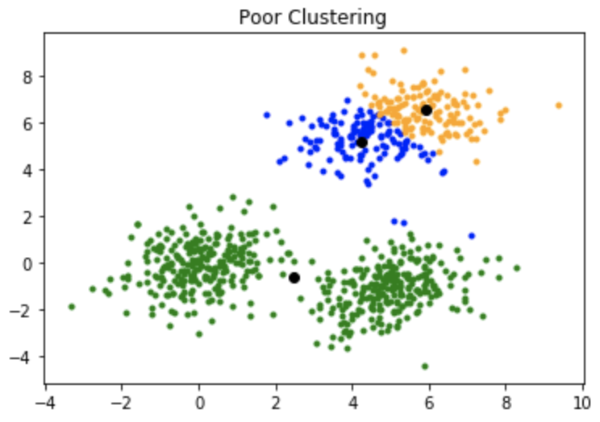
Drawback of K-means algorithm
it is sensitive to the initialization of the centroids or the mean points.
So, if a centroid is initialized to be a “far-off” point, it might just end up with no points associated with it, and at the same time, more than one cluster might end up linked with a single centroid.
Similarly, more than one centroids might be initialized into the same cluster resulting in poor clustering.

Slide 20
K-Means++
K-means++ is a smart centroid initialization method for the K-mean algorithm.
The goal is to spread out the initial centroid by assigning the first centroid randomly then selecting the rest of the centroids based on the maximum squared distance.
The idea is to push the centroids as far as possible from one another.

Slide 21
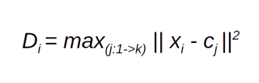
K-Means++(Algorithm)
Randomly pick the first centroid (C1)
Calculate the distance between all data points and the selected centroid
This denotes the distance of a data point x_{i} from the farthest centroid C_{j}
Initialize the data point x_{i} as the new centroid
Repeat steps 3 and 4 till all the defined K clusters are found

Slide 22
Mini-Batch k-means
In traditional K-means, the algorithm processes the entire dataset in each iteration, which can be computationally expensive for large datasets.
Mini-batch K-means addresses this issue by processing only a small subset of the data, called a mini-batch, in each iteration.
The mini-batch is randomly sampled from the dataset, and the algorithm updates the cluster centroids based on the data in the mini-batch.
This allows the algorithm to converge faster and use less memory than traditional K-means.
Main idea is to use small random batches of data of a fixed size, so they can be stored in memory.
Each iteration a new random sample from the dataset is obtained and used to update the clusters and this is repeated until convergence.

Slide 23

K-Medoids
A medoid can be defined as a point in the cluster, whose dissimilarities with all the other points in the cluster are minimum.
The dissimilarity of the medoid(C_{i}) and object(P_{i}) is calculated by using E = |P_{i} – C_{i}|
The cost in K-Medoids algorithm is given as

Slide 24
K-Medoids(Algorithm)
Initialize: select k random points out of the n data points as the medoids.
Associate each data point to the closest medoid by using any common distance metric methods.
While the cost decreases: For each medoid m, for each data o point which is not a medoid:
Swap m and o, associate each data point to the closest medoid, and recompute the cost.
If the total cost is more than that in the previous step, undo the swap.

Slide 25
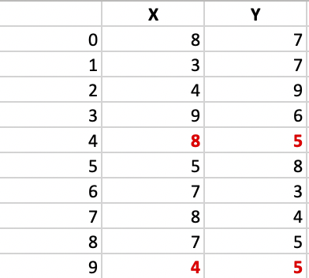
K-Medoids(Example)
Let’s consider the example:
Step 1: Let the randomly selected 2 medoids, so select k = 2, and let C1 -(4, 5) and C2 -(8, 5) are the two medoids.

Slide 26
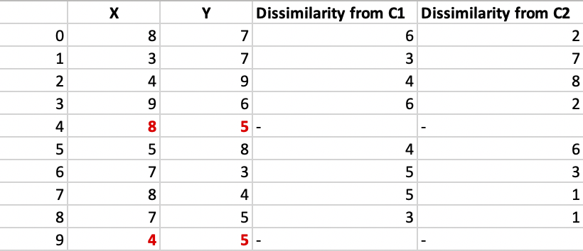
K-Medoids(Example)
Step 2: Calculating cost. The dissimilarity of each non-medoid point with the medoids is calculated and tabulated:
Here we have used Manhattan distance formula to calculate the distance matrices between medoid and non-medoid points. That formula tell that Distance = |X1-X2| + |Y1-Y2|.
Each point is assigned to the cluster of that medoid whose dissimilarity is less. Points 1, 2, and 5 go to cluster C1 and 0, 3, 6, 7, 8 go to cluster C2. The Cost = (3 + 4 + 4) + (3 + 1 + 1 + 2 + 2) = 20

Slide 27
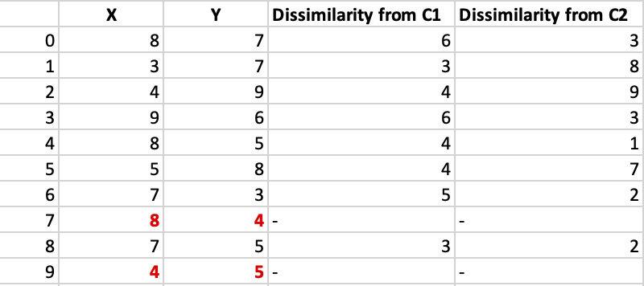
K-Medoids(Example)
Step 3: randomly select one non-medoid point and recalculate the cost. Let the randomly selected point be (8, 4). The dissimilarity of each non-medoid point with the medoids – C1 (4, 5) and C2 (8, 4) is calculated and tabulated.
Each point is assigned to that cluster whose dissimilarity is less. So, points 1, 2, and 5 go to cluster C1 and 0, 3, 6, 7, 8 go to cluster C2.
The New cost = (3 + 4 + 4) + (2 + 2 + 1 + 3 + 3) = 22 Swap Cost = New Cost – Previous Cost = 22 – 20 and 2 >0 As the swap cost is not less than zero, we undo the swap.
Hence (4, 5) and (8, 5) are the final medoids.

Slide 28
K-Medoids
Advantages:
It is simple to understand and easy to implement.
K-Medoid Algorithm is fast and converges in a fixed number of steps.
PAM(Partitioning Around Medoids) is less sensitive to outliers than other partitioning algorithms.
Disadvantages:
The main disadvantage of K-Medoid algorithms is that it is not suitable for clustering non-spherical (arbitrarily shaped) groups of objects. This is because it relies on minimizing the distances between the non-medoid objects and the medoid (the cluster center).
It may obtain different results for different runs on the same dataset because the first k medoids are chosen randomly.

Slide 29
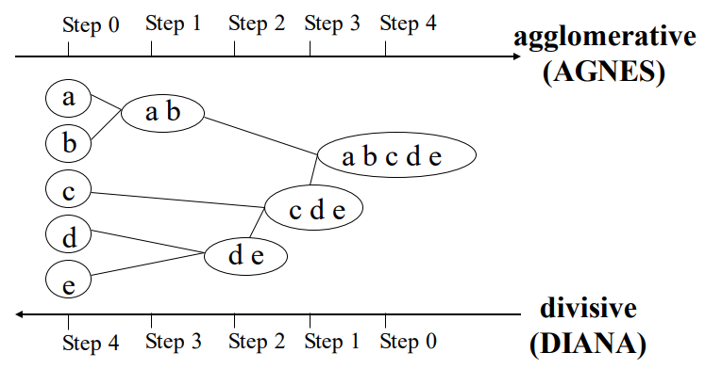
Hierarchical Clustering
In this method, a hierarchical decomposition of the given set of data objects is created.
Use distance matrix as clustering criteria.
This method does not require the number of clusters k as an input, but needs a termination condition
There are two types of approaches for the creation of hierarchical decomposition, they are:
Agglomerative Approach:
Divisive Approach:

Slide 30
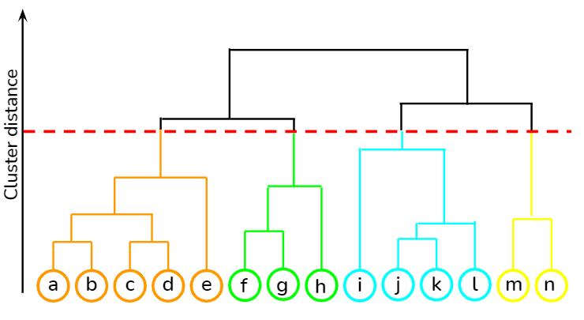
Dendrogram: Shows How the Clusters are Merged
Decompose data objects into a several levels of nested partitioning (tree of clusters), called a dendrogram.
A clustering of the data objects is obtained by cutting the dendrogram at the desired level, then each connected component forms a cluster.

Slide 31
Agglomerative Approach
The agglomerative approach is also known as the bottom-up approach.
Initially, each data point is a cluster of its own, further pairs of clusters are merged as one moves up the hierarchy.
Steps:
Initially, all the data-points are a cluster of its own.
Take two nearest clusters and join them to form one single cluster.
Proceed recursively step 2 until you obtain the desired number of clusters.

Slide 32
How to join two clusters to form one cluster?
To obtain the desired number of clusters, the number of clusters needs to be reduced from initially being n cluster (n equals the total number of data-points).
Two clusters are combined by computing the similarity between them.
There are some methods which are used to calculate the similarity between two clusters:
Single link: Distance between two closest points in two clusters.
i.e., dis(K_{i} , K_{j} ) = min(t_{ip}, t_{jq})
Complete link: Distance between two farthest points in two clusters.
i.e. dis(K_{i} , K_{j} ) = max(t_{ip}, t_{jq})
Average: The average distance between all points in the two clusters.
i.e. dis(K_{i} , K_{j} ) = avg(t_{ip}, t_{jq})
Centroid: Distance between centroids of two clusters.
i.e. dis(K_{i} , K_{j} ) = dis(C_{i} , C_{j} )

Slide 33
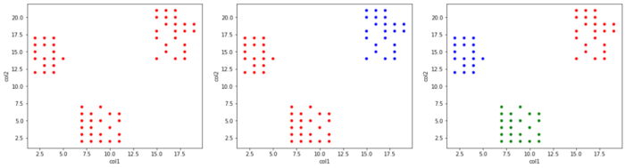
Divisive Approach
The divisive approach is also known as the top-down approach.
In this approach, we would start with the data objects that are in the same cluster.
The group of individual clusters is divided into small clusters by continuous iteration.
The iteration continues until the condition of termination is met or until each cluster contains one object.

Slide 34
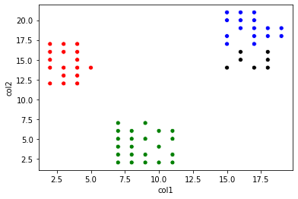
Divisive Approach
In the previous sample dataset, it is observed that there is 3 cluster that is far separated from each other. So we stopped after getting 3 clusters.
Even if start separating further more clusters, below is the obtained result.

Slide 35
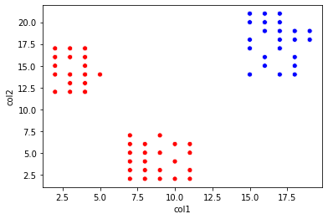
How to choose which cluster to split?
Check the sum of squared errors of each cluster and choose the one with the largest value.
In the given 2-dimension dataset, currently, the data points are separated into 2 clusters, for further separating it to form the 3rd cluster find the sum of squared errors (SSE) for each of the points in a red cluster and blue cluster.
The cluster with the largest SSE value is separated into 2 clusters, hence forming a new cluster.
In the given image, it is observed red cluster has larger SSE so it is separated into 2 clusters forming 3 total clusters.

Slide 36
Density based Clustering Method
Partition-based and hierarchical clustering techniques are highly efficient with normal shaped clusters.
However, when it comes to arbitrary shaped clusters or detecting outliers, density-based techniques are more efficient.
Clustering based on density (local cluster criterion), such as density-connected points
Major features:
Discover clusters of arbitrary shape
Handle noise
very effienct at finding high-density regions and outliers.
Need density parameters as termination condition

Slide 37
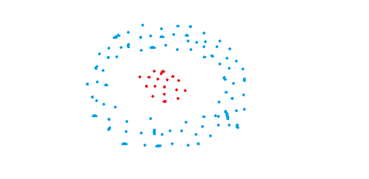
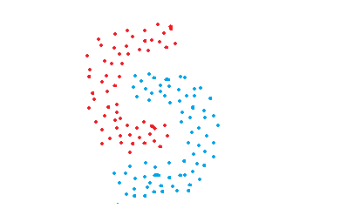
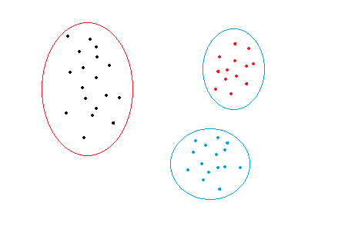
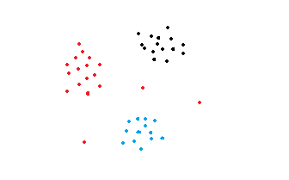
Density based Clustering Method
For example, the dataset in the figure below can easily be divided into three clusters using k-means algoritm.
Consider the following figures:

Slide 38
DBSCAN
DBSCAN stands for (Density-Based Spatial Clustering of Applications with Noise.
It is able to find arbitrary shaped clusters and clusters with noise (i.e. outliers).
The main idea behind DBSCAN is that a point belongs to a cluster if it is close to many points from that cluster.
There are two key parameters of DBSCAN:
eps: The distance that specifies the neighborhoods. Two points are considered to be neighbors if the distance between them are less than or equal to eps.
minPts: Minimum number of data points to define a cluster.
Based on these two parameters, points are classified as
Core point: A point is a core point if there are at least minPts number of points (including the point itself) in its surrounding area with radius eps.
Border point: A point is a border point if it is reachable from a core point and there are less than minPts number of points within its surrounding area.
Outlier: A point is an outlier if it is not a core point and not reachable from any core points.

Slide 39
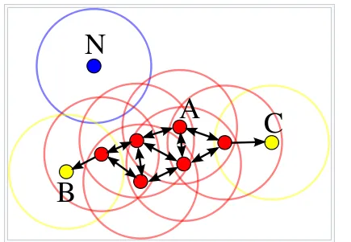
DBSCAN
In this case, minPts is 4.
Red points are core points because there are at least 4 points within their surrounding area with radius eps. This area is shown with the circles in the figure.
The yellow points are border points because they are reachable from a core point and have less than 4 points within their neighborhood.
Reachable means being in the surrounding area of a core point.
The points B and C have two points (including the point itself) within their neigborhood (i.e. the surrounding area with a radius of eps).
Finally N is an outlier because it is not a core point and cannot be reached from a core point.

Slide 40
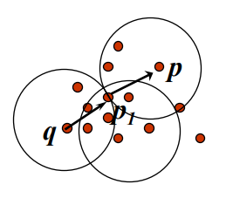
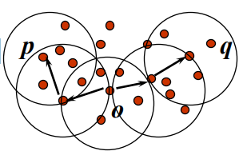
Density-Reachable and Density-Connected
Density-reachable:
A point p is density-reachable from a point q w.r.t. Eps, MinPts if there is a chain of points p₁ , …, p_{n} , p₁ = q, p_{n} = p such that p_{i+1} is directly density-reachable from p_{i}
Density-connected
A point p is density-connected to a point q w.r.t. Eps, MinPts if there is a point o such that both, p and q are density-reachable from o w.r.t. Eps and MinPts

Slide 41
DBSCAN(Algorithm)
Arbitrary select a point p
Retrieve all points density-reachable from p w.r.t. Eps and MinPts.
If p is a core point, a cluster is formed.
If p is a border point, no points are density-reachable from p and DBSCAN visits the next point of the database.
Continue the process until all of the points have been processed.

Slide 42
Outlier analysis
Outlier analysis is the process of identifying outliers, or abnormal observations, in a dataset.
Also known as outlier detection, it’s an important step in data analysis, as it removes erroneous or inaccurate observations which might otherwise skew conclusions.
part of any data analysis procedure.
when the dataset reaches steps that truly involve assessing and interpreting the data, any outliers will have already been removed.
it improves the quality of the dataset being subject to analysis.

Slide 43
Outlier Analysis Techniques
Sorting
load your dataset into any kind of data manipulation tool (such as a spreadsheet), and
sort the values by their magnitude. Then, look at the range of values of various data points.
If any data points are significantly higher or lower than others in the dataset, they may be treated as outliers.
Graphing
plot all of the data points on a graph, and see which points stand out from the rest.
The advantage of using a graphing approach over a sorting approach is that it visualizes the magnitude of the data points, which makes it much easier to spot outliers.

